Slide 1

SPETLR
SPark ETL libRary (SPETLR)
An open-source framework for Data Engineering in Azure Databricks
Webpage: https://spetlr.com/
Github repo: https://github.com/spetlr-org/spetlr

Slide 2
WHAT – is SPETLR?
Open source
Github
Python library
ETL best practices
SPETLR core features
  Standardized structures facilitate cooperation in large teams
  Standard connectors with commonly use options reduce boilerplate
  Additional layer of data abstraction allows full unit-testing
CICD enablement
Python and SQL files code (yml configurations)
No notebooks

Slide 3
WHY – Choose SPETLR if you need…
Standardized framework for ETL processes which facilitate cooperation in large teams and complex enterprise lakehouse platforms
A reliable fully unit and integration tested Lakehouse platform
CICD enablement
Open-source approach (“no secrets”)
Maintained code: SPETLR contributors ensures that your lakehouse ETL code is maintained.
Reusability of ETL processes across multiple projects

Slide 4
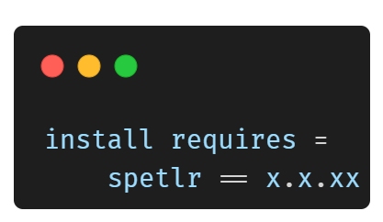
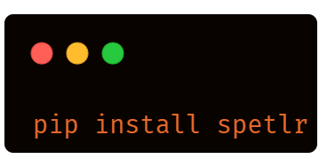
PROCESS - Use SPETLR
Pypi package
Terminal
(or even in a notebook)
setup.cfg

Slide 5
Technical overview
Github repo
src/
test/local (Unit tests)
test/cluster (Integration tests)
Distributed as PyPI package
Pre-integration Github workflow TESTS on every time:
Deployment of Lakehouse platform (Bicep and Powershell)
Azure resources
Azure Databricks
Azure Eventhub
Azure Sql Server and database
Azure cosmos
Azure storage account …
Azure keyvault

Slide 6
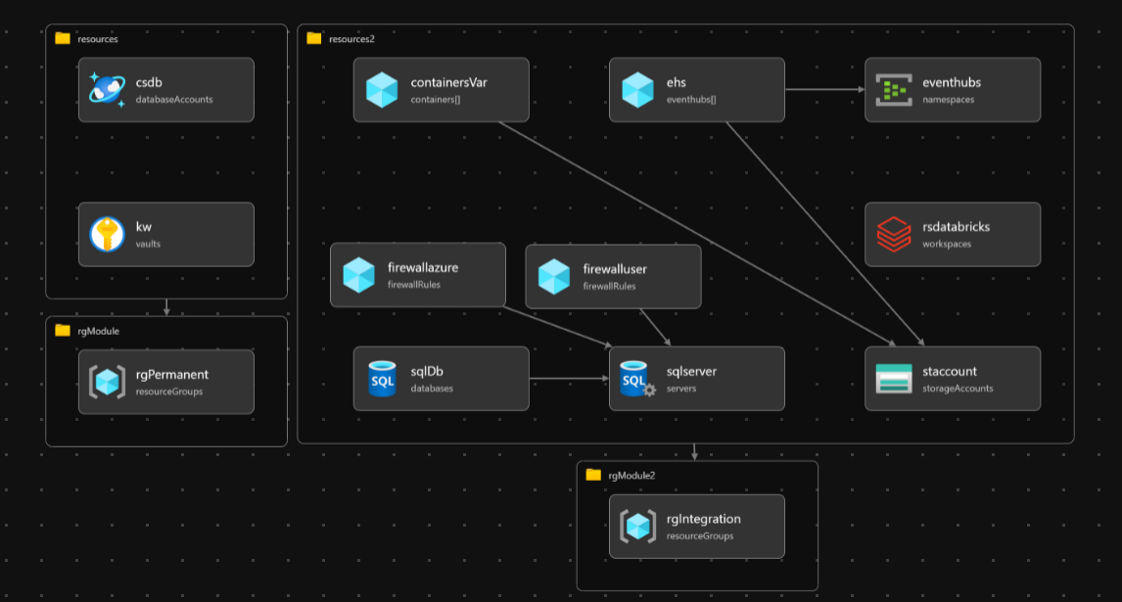
Technical overview
https://github.com/spetlr-org/spetlr/blob/main/.github/TEST_ARCHITECTURE.md

